Slide 1
A complete job portal IBM HACKATHON
JOB-AMIGO
Presented
By
Kommineni Siva Krishna
Thallapalli Ravisha
Bandaru Sarath Chandra
Yempalla Suresh Reddy

Slide 2
Contents
Introduction
Idea
Technologies Used
Implementation
Conclusion

Slide 3
Introduction
Developing an native mobile app for user friendly job search.
Searches jobs based on the country codes.
Retrieves data to the user.

Slide 4
IDEA
The application is designed for easy search of jobs for the job seekers based on the search criteria using country codes.
It is free of cost and benefits mainly the job seekers who are searching for the jobs with low income and low skills and profile also.

Slide 5
Technologies Used
Android SDK
Bluemix mobile cloud
Bluemix mobile data

Slide 6
How it Works
Search jobs based on the country codes
Complete details of job are retrieved back in the UI.
We used career builder API for the job list retrieval.
Later they can apply to the job directly which is stored in DB for further reference.

Slide 7
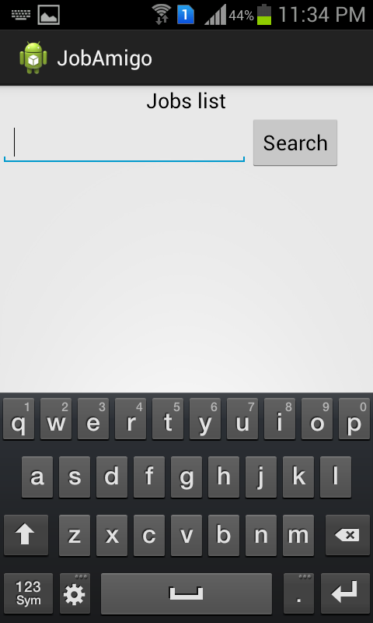
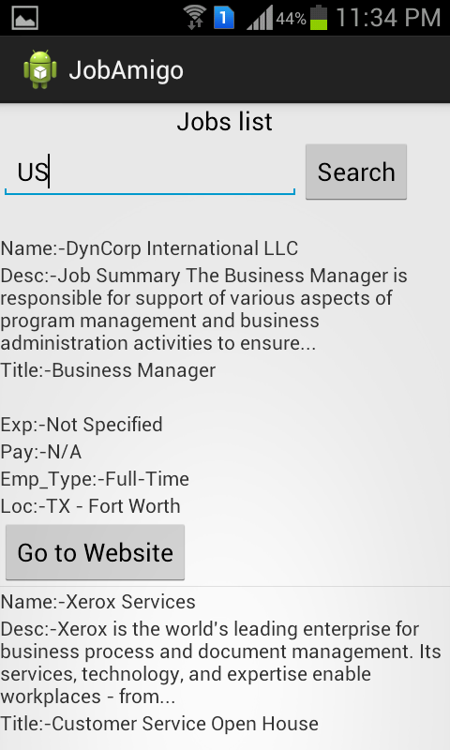

Slide 8

CONCLUSION
Helps in searching jobs easily for the users.

